Slide 1
Investor Pitch Deck
July 2020

Slide 2
Introduction
1
THE NIVA LABS:
California Licensed Cannabis Testing Lab in Los Angeles.
Much more than testing, we offer services for all stakeholders in the industry including cultivators, manufacturers, distributors, physicians, and researchers.
2
NIVA RESEARCH:
Contract Research division for pharmaceutical and biotech & cannabis and CBD companies.

Slide 3
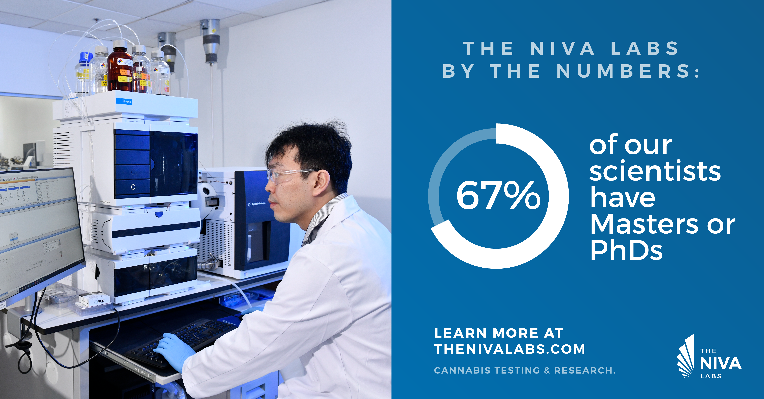
Our Mission
To take cannabis testing and research to the next level through:
The Niva Labs Difference
Testing Excellence
Quality | Customer Service | Collaborative Partnerships
Best In Class Technology
Product development
Brand-Elevating Research

Slide 4
Testing Market Opportunity
1
Cannabis
Retail Market
Cannabis
Testing Market
Other Testing Markets
2019 CA Market
$3.8B
2019 CA Market
$100M
CBD and Hemp
Nutraceuticals
Projected Annual Growth
19%
Food and Beverage

Slide 5
The Contract Research Opportunity
2
Clients: Pharma & Biotech
Global R&D spending: $190B in 2020
Contract Research is growing faster (11.4% CAGR) than total R&D spending
25% ($47B) is outsourced to Contract Research labs
https://www.fortunebusinessinsights.com/industry-reports/contract-research-organization-cro-services-market-100864

Slide 6
Revenue Streams
TOTAL NIVA LABS REVENUE POTENTIAL by 2024: $74M
GROUP I
California Cannabis Testing
California Consumer Retail Market | 4,000,000,000
Testing Labs Share of the Market (%) | 4%
Testing Labs Share of the Market ($) | 160,000,000
Niva Labs Potential Market Share (%) | 10%
Niva Labs Potential Market Share ($) | 16,000,000
GROUP II
Hemp & CBD Testing
Niva Labs Potential Market Share (%) | 2%
Niva Labs Potential Market Share ($) | 1,000,000
GROUP III
Consulting (Cannabis Testing)
Niva Labs Potential Market Share (%) | 5%
Niva Labs Potential Market Share ($) | 10,000,000
GROUP IV
Contract Research (Pharma, Biotech & Cannabis)
Niva Labs Potential Market Share (%) | 0.10%
Niva Labs Potential Market Share ($) | 47,000,000
TOTAL NIVA LABS REVENUE POTENTIAL
by 2024: $74M ANNUALLY

Slide 7
Our Unique Business Model
Most Labs
The Niva Labs
Cannabis Testing
Contract Research:
Pharma & Biotech
Cannabis/CBD
CBD Testing

Slide 8
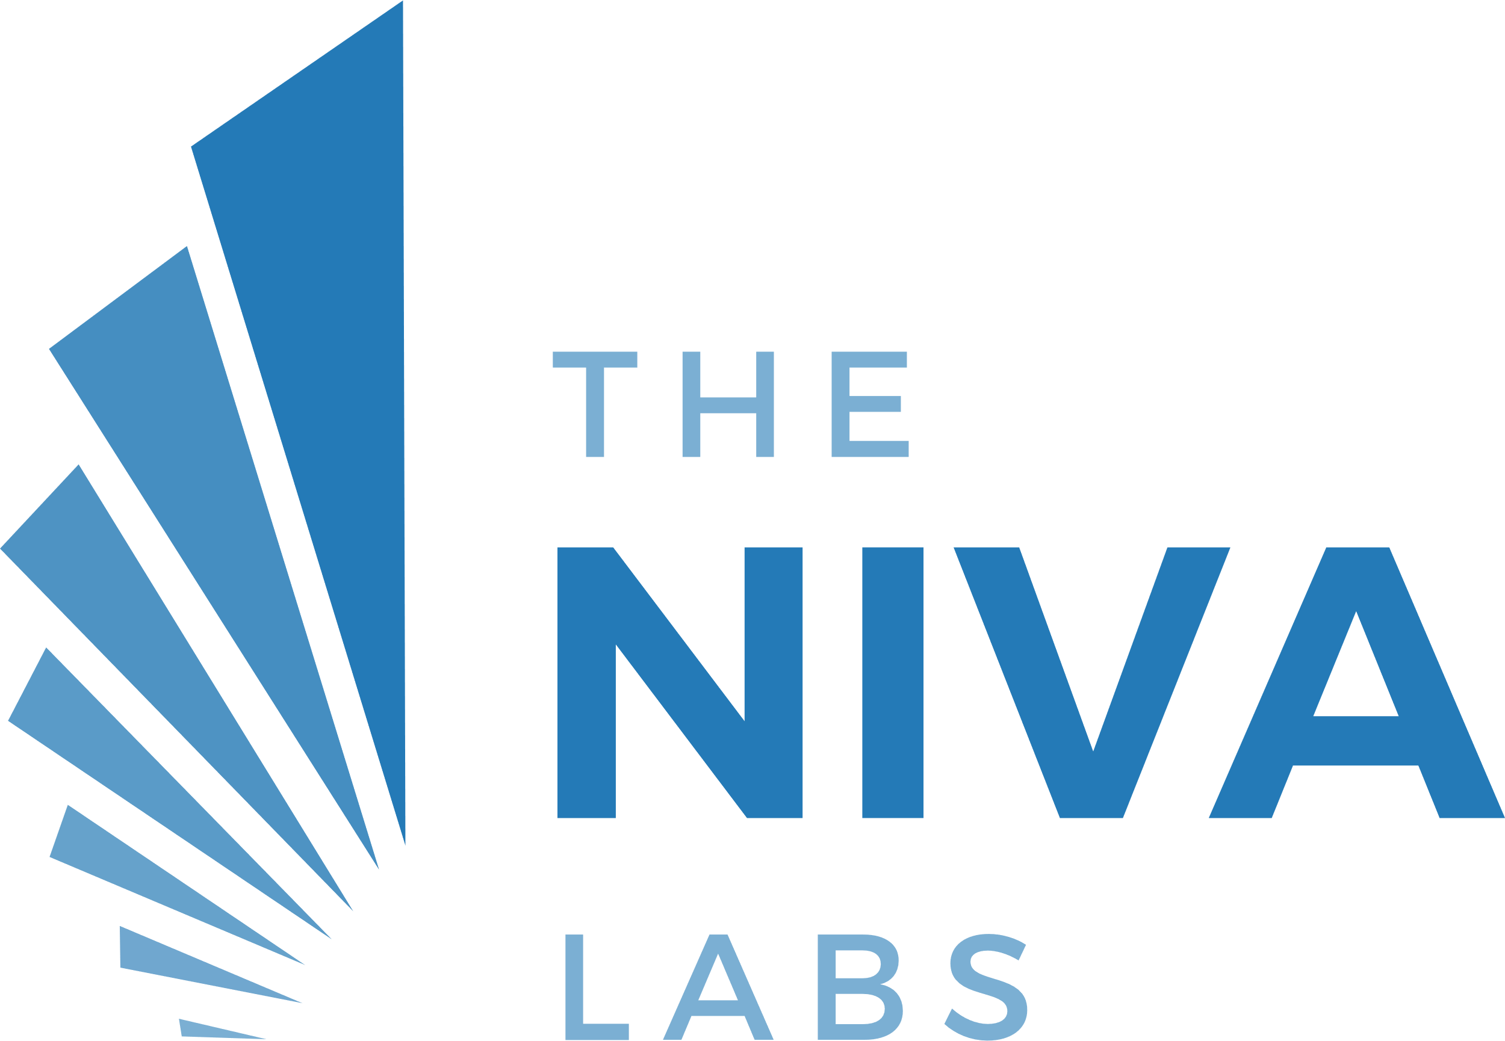
Differentiators
Drug Discovery
Research
Drug Discovery R&D for pharma and biotech
Product Dev
Paid contract research for cannabis and CBD companies
Government grants
Big Data partnerships: Link Testing Data to Clinical Data
Troubleshooting
Manufacturing troubleshooting
Support new product development
Testing
Product Shelf Life
Environmental Monitoring
Genetic Testing
State Required Panel
Preliminary QC Testing

Slide 9
Our Team
Josh Snyder; CEO
Josh has 21 years in Biotech & Pharma R&D and management with expertise in analytical chemistry, cancer drug development, biochemistry, and cell biology. Board of Advisors for Aya Biosciences (pharmaceutical startup).
Kris Marsh, Ph.D.; Lab Director
Kris joined the cannabis testing industry in the San Francisco Bay Area in 2017, prior to full legalization. He is a published scientific author in peer-reviewed journals and received his Ph.D. in materials chemistry from UCLA.
Our Background
Cannabis Testing
Nobumitsu Sakai, Ph.D.; Sr. Analytical Chemist
Nobu has a Ph.D. in environmental engineering from Kyoto University, and 13 years of nanoparticle research and environmental research using LC-MS/MS, GC-MS and ICP-MS to study environmental pollution and its effects on human and animal health.
Contract Research
Pharma & Biotech
Mike Burke, VP Sales & Marketing
35 years in sales
Lab sales and healthcare
Co-founder of a hemp-infused nutraceutical company
Cancer Drug Development
1st month on the job at Niva
Brought in a $30k/month client and increased sales with existing clients
Revamped the marketing program
Cannabis Extraction & manufacturing
Environmental Research & Testing
Nutraceutical manufacturing & testing
Ryan O’Connell, Sales
6 years in sales, #1 rep out of 17
Knowledge of Cannabis market
Combined - over 90 Years of Experience

Slide 10
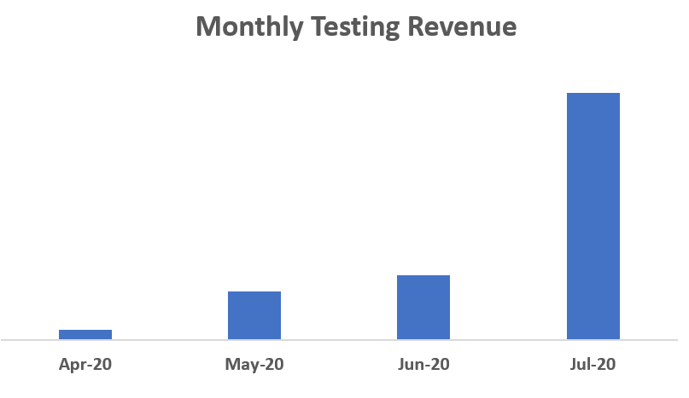
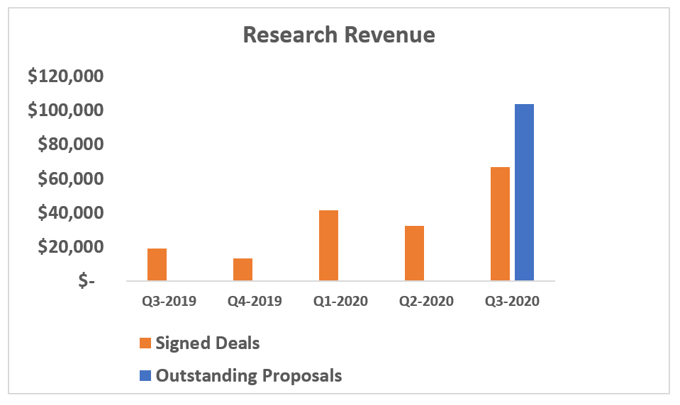
Revenue To Date
Received
License
Testing
Exponential growth
Top-5 brand signed
Discussions with other major brands
Research Contracts
$172K signed by CEO without sales team
Another $102K in proposals awaiting signature
Q3-2020 is for
July only

Slide 11
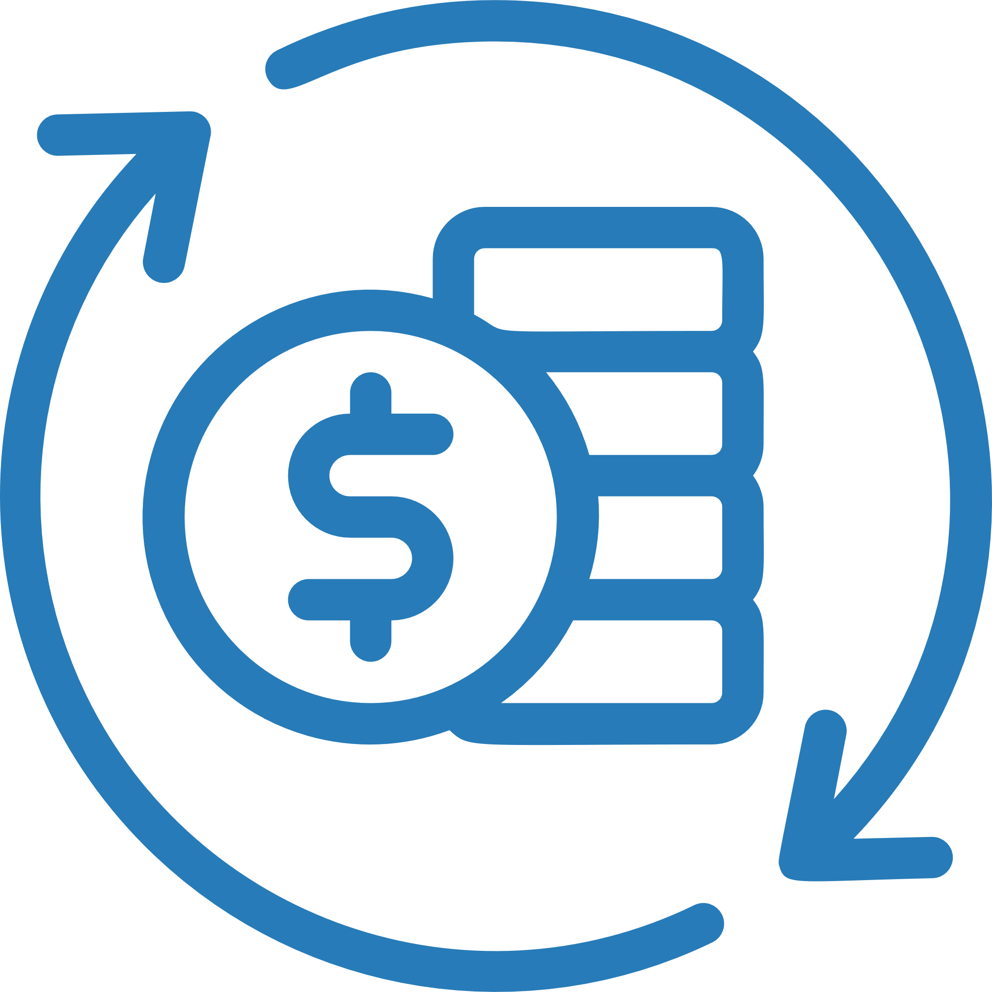
Perfect Timing for Market Entry
Advantages of NOT being early to market:
We learned from the mistakes of other testing labs:
$$ Savings: wrong equipment, costly software development
Bottom Line
The market has been missing what we have to offer…see testimonials
Avoiding the pitfalls of Temporary Licensing (2018):
Reputation not damaged by unpreparedness and/or loss of license
Pre-launch development of services not offered by other labs

Slide 12
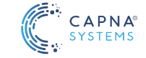
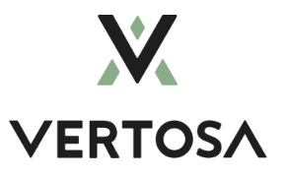
Client Testimonials
Ethanol extraction Multi-national
Major cannabis brand CA and Israel World leaders in cannabis research
Leader in cannabinoid emulsion technology for beverage companies
“It was very challenging to find an analytical partner that was willing to take on our project.”
- Gene Galyuk CTO, Capna Systems
“We are looking forward to a long and fruitful collaboration with the Niva Labs.”
- Vardan Ter-Antonyan, VP of Product Development Tikun Olam, USA
“Niva Labs is at the forefront of becoming the trusted third party tester and certifier of water soluble cannabis.”
- Harold Han Founder and CTO, Vertosa

Slide 13
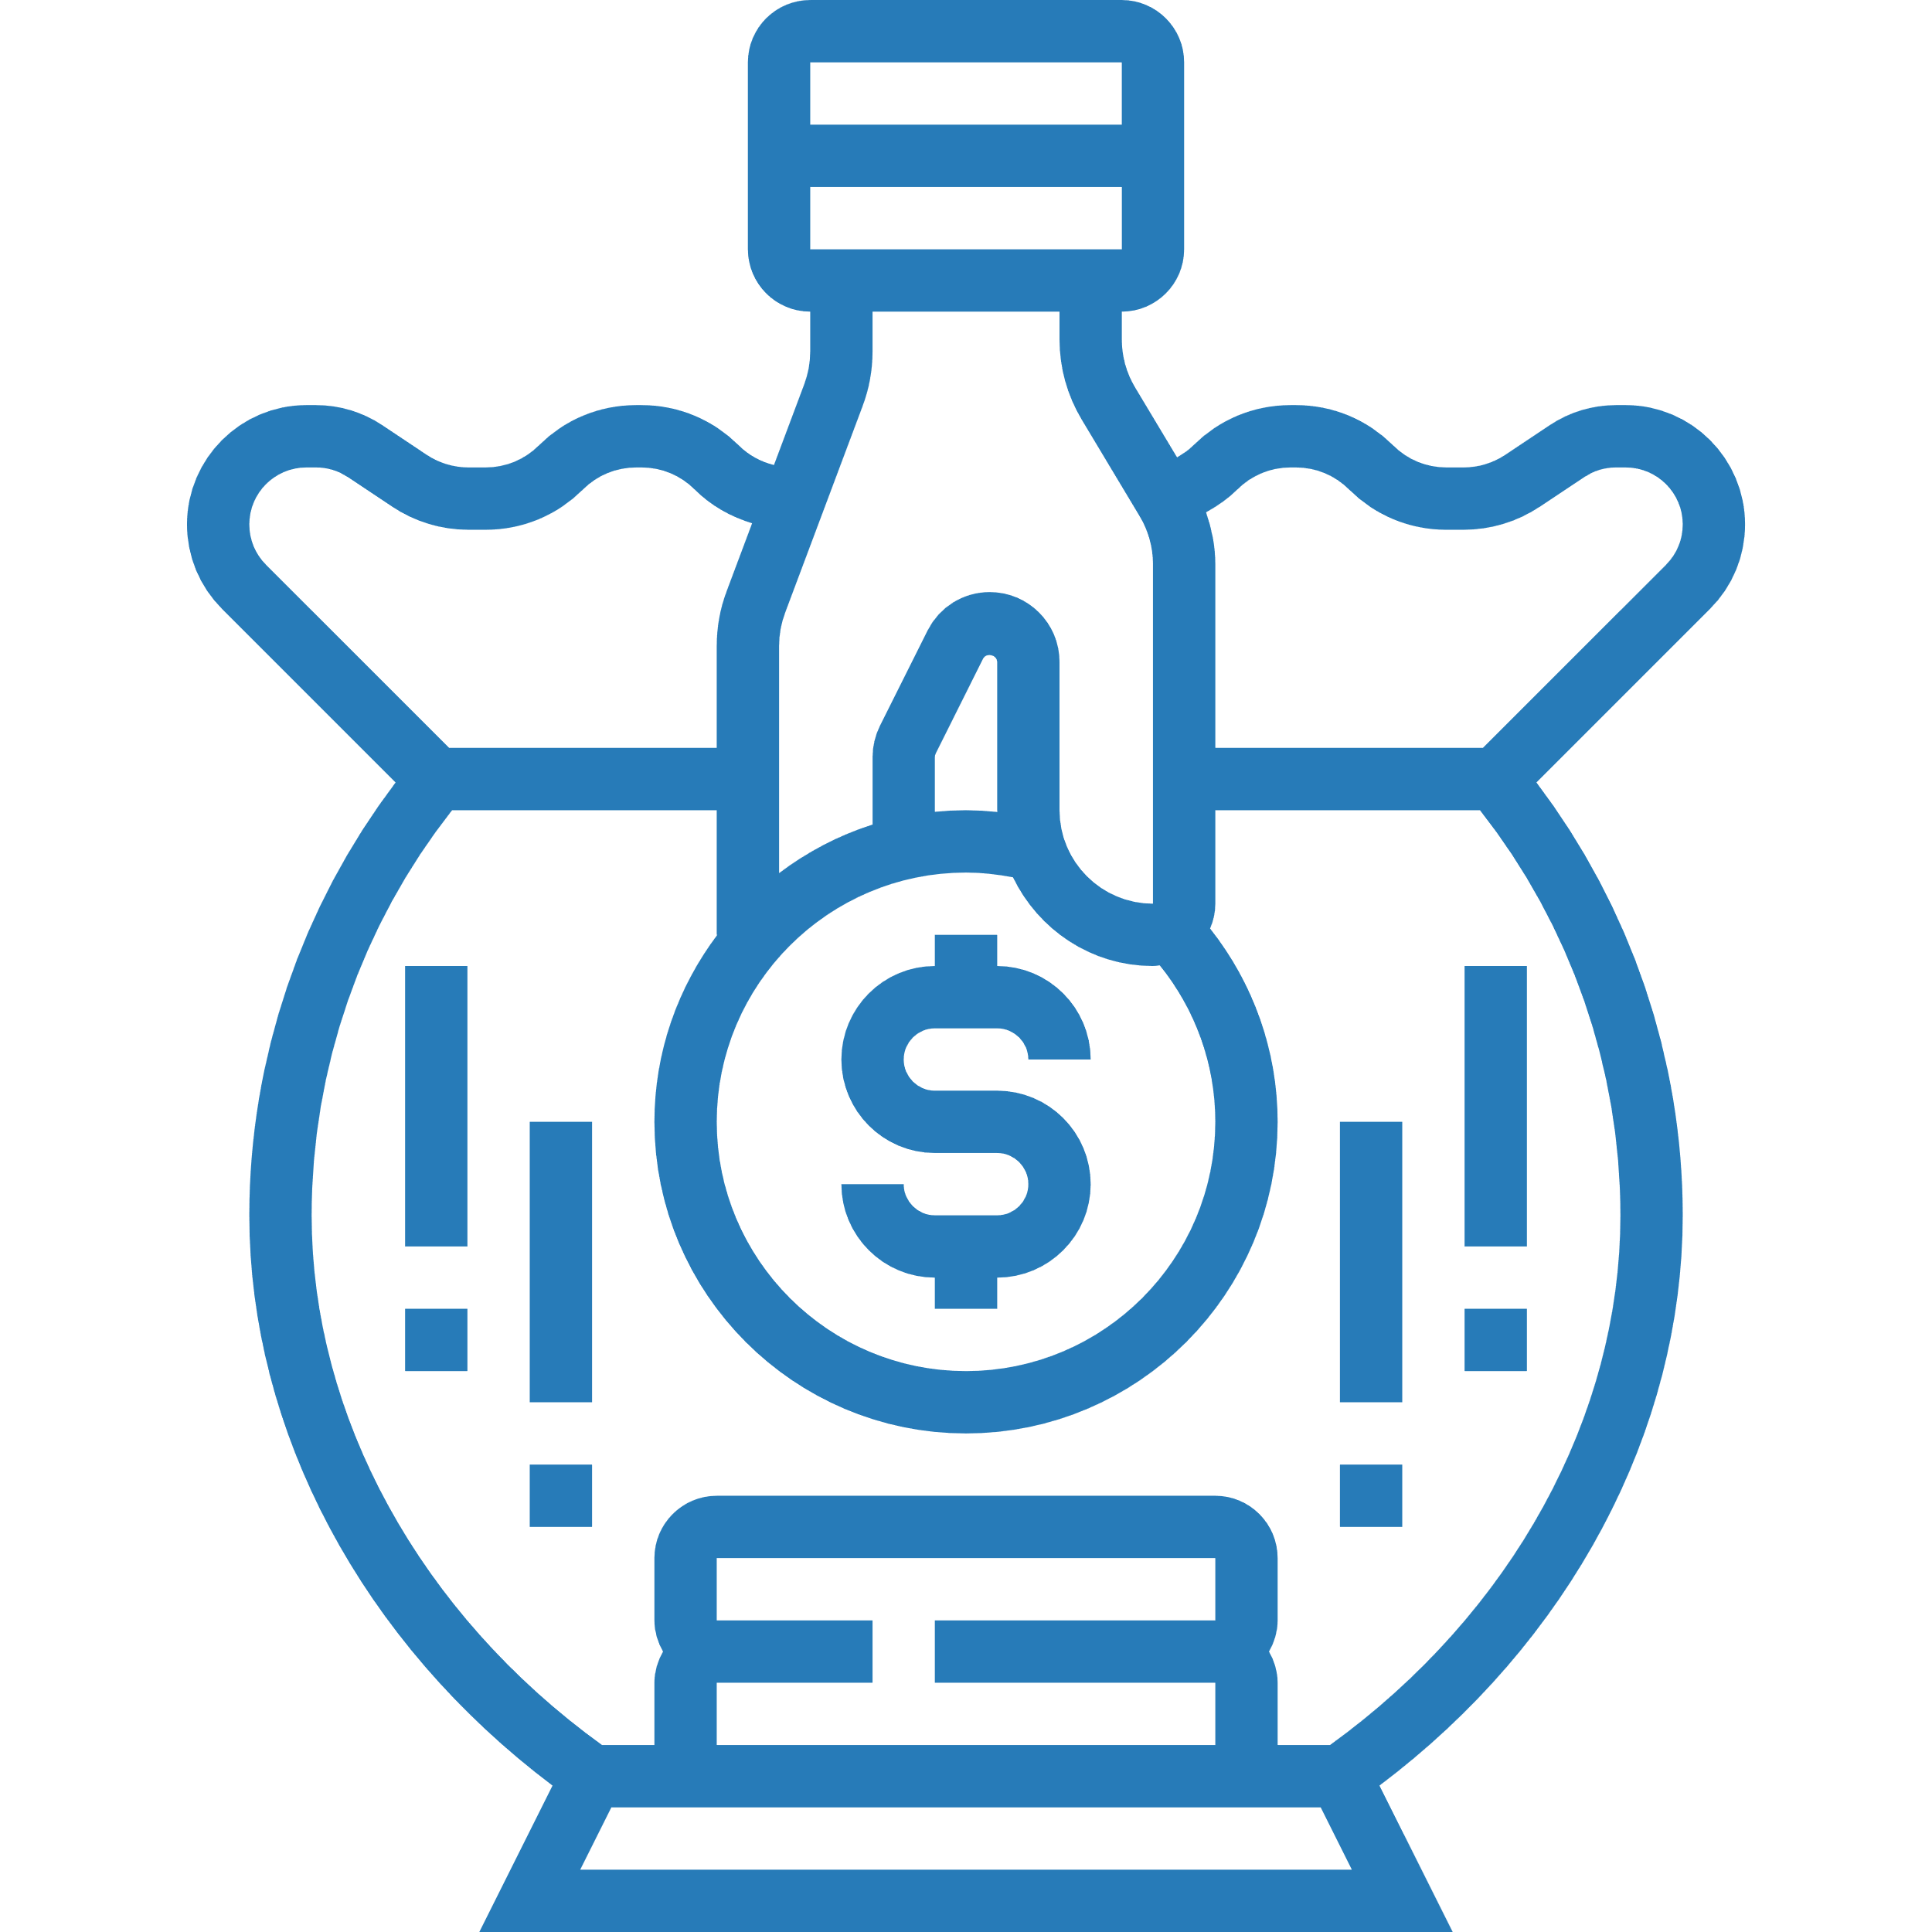
Sources, Uses and Needs
Sources of Funding to Date
Uses of Funds to Date
Single high net worth family
Equipment
Facility improvements and licensing
Revenue during soft launch
Operating expenses
Current Series A Capital Raise
$1.3M: Equipment
$0.4M: Sales & Marketing
$0.3M: New hires
We are raising $2M in additional funding to grow our business rapidly and see us through to positive cash flow.

Slide 14
THANK YOU!
Josh Snyder
CEO
310.699.1553
Josh.Snyder@thenivalabs.com
www.thenivalabs.com
Los Angeles, CA

